Slide 1
CSE-212 Object Oriented Programming (Java) Some OOP Concepts
Department of Computer Science and Engineering
Jahangirnagar University

Slide 2
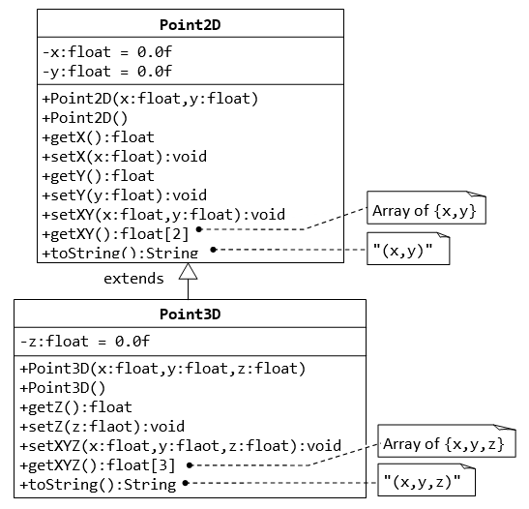
Today’s experiments – 1 (Inheritance)
//Rough………
public class Point2D{
…….
public float[] getXY()
{
float[] XY= new float[2];
XY[0] = x;
XY[1] = y;
return XY;
}
…
//override builtin toString method
public String toString()
{
return “ ( ” + x + “,” + y + ”)”;
}
}
public class Point3d extends Point2D{
private float z = 0.0f ;
…….
…
public String toString()
{
return “(“ + getX()+ “,”+getY()+ “,”+ z + ”)”;
}
}
public class Tester
{
public static void main(String args[])
{
Point2D p1 = new Point2D();
Point2D p2 = new Point2D(4.6,1.2);
float[] temp = p2.getXY();
System.out.println(“x= ” + temp[0]+”y= ”+ temp[1]);
System.out.println(p1); //calling toString() method..
……
}
}
Write a java code to simulate the following scenario.

Slide 3
Today’s experiments – 2 (Abstract Class)
Write an abstract class ‘Instrument’ which will have abstract method ‘play’, ‘adjust’ & concrete method ‘compose’.
Use the abstract class ‘Instrument’ to create class ‘Guitar’, ‘Keyboard’ & ‘Violin’.
Create instance (object) of every classes invoking(calling) every method. The method will print any message with ‘Instrument name’ and ‘Purpose’,
The method ‘play’ for ‘Violin’ class will print “In the playing method of Violin”

Slide 4
Today’s experiments – 3 (Abstract Class)
Write a abstract superclass called Shape, which contains:
Two protected instance variables color(String) and filled(boolean). The protected variables can be accessed by its subclasses and classes in the same package.
Two constructors: a no-arg (no-argument) constructor that initializes the color to "green" and filled to true, and a constructor that initializes the color and filled to the given values.
Getter and setter for all the instance variables. By convention, the getter for a boolean variable xxx is called isXXX() (instead of getXxx() for all the other types).
A toString() method that returns "A Shape with color of xxx and filled/Not filled".
Two abstract methods getArea() and getPerimeter()
The subclasses Circle and Rectangle shall override the abstract methods getArea() and getPerimeter() and provide the proper implementation. They also override the toString().

Slide 5
Today’s experiments – 3 Cont. (Abstract Class)
Write two subclasses of Shape called Circle and Rectangle, as shown in the class diagram.
The Circle class contains:
An instance variable radius (double).
Three constructors as shown. The no-arg constructor initializes the radius to 1.0.
Getter and setter for the instance variable radius.
Override methods getArea() and getPerimeter().
Override the toString() method inherited, to return "A Circle with radius=xxx, which is a subclass of yyy", where yyy is the output of the toString() method from the superclass.
The Rectangle class contains:
Two instance variables width (double) and length (double).
Three constructors as shown. The no-arg constructor initializes the width and length to 1.0.
Getter and setter for all the instance variables.
Override methods getArea() and getPerimeter().
Override the toString() method inherited, to return "A Rectangle with width=xxx and length=zzz, which is a subclass of yyy", where yyy is the output of the toString() method from the superclass.

Slide 6
Today’s experiments – 3 Cont. (Abstract Class)
Write a class called Square, as a subclass of Rectangle. Convince yourself that Square can be modeled as a subclass of Rectangle. Square has no instance variable, but inherits the instance variables width and length from its superclass Rectangle.
Provide the appropriate constructors (as shown in the class diagram). Hint:
public Square(double side) {
super(side, side); // Call superclass Rectangle(double, double)
}
Override the toString() method to return "A Square with side=xxx, which is a subclass of yyy", where yyy is the output of the toString() method from the superclass.
Do you need to override the getArea() and getPerimeter()? Try them out.
Override the setLength() and setWidth() to change both the width and length, so as to maintain the square geometry.

